Slide 1
ITEC 696 Python Programming for Business Analytics
Grant Fiddyment
Data Scientist, Philadelphia 76ers
Adjunct, American University

Slide 2
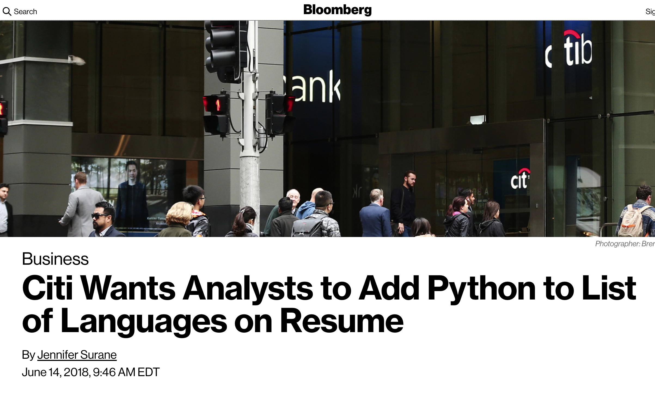

Slide 3
Estimated savings from using open source software, per year:
$60 billion
> median world GDP

Slide 4
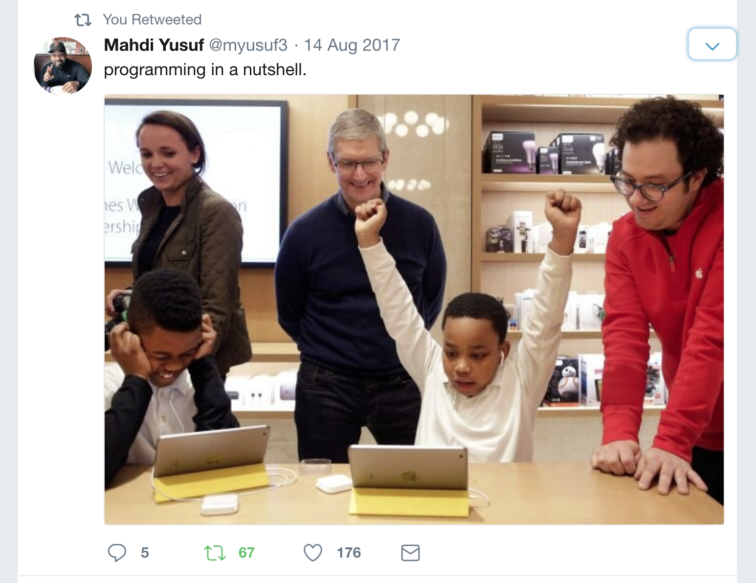

Slide 5
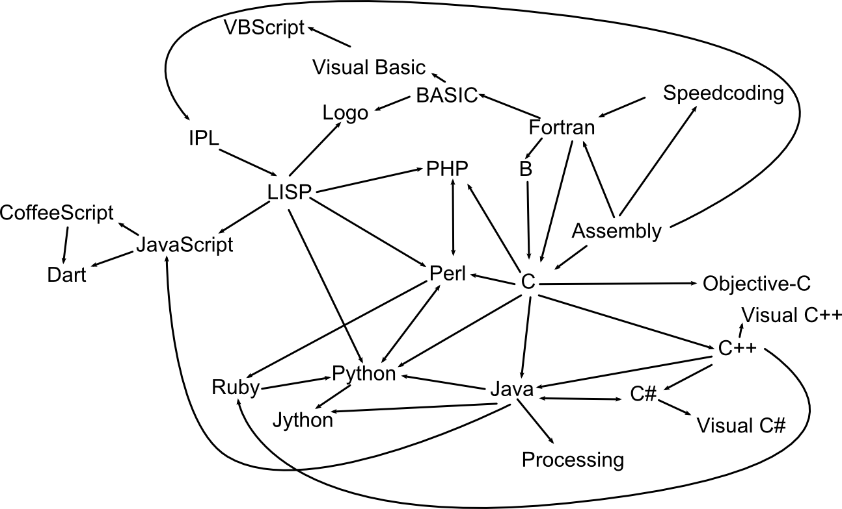
1996
SGML 1986
HTML 1993
Markdown 2004
1991
1964
1957
1958
1949
1995
1987
1972
1995
1995
1985
1990
2000

Slide 6
What is code?
Encoded language
MARKDOWN EXAMPLE

Slide 7
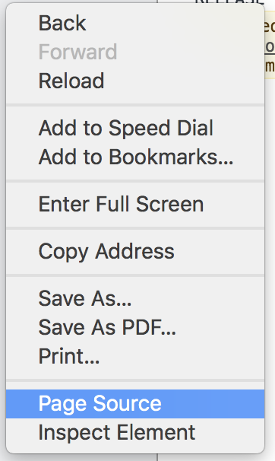
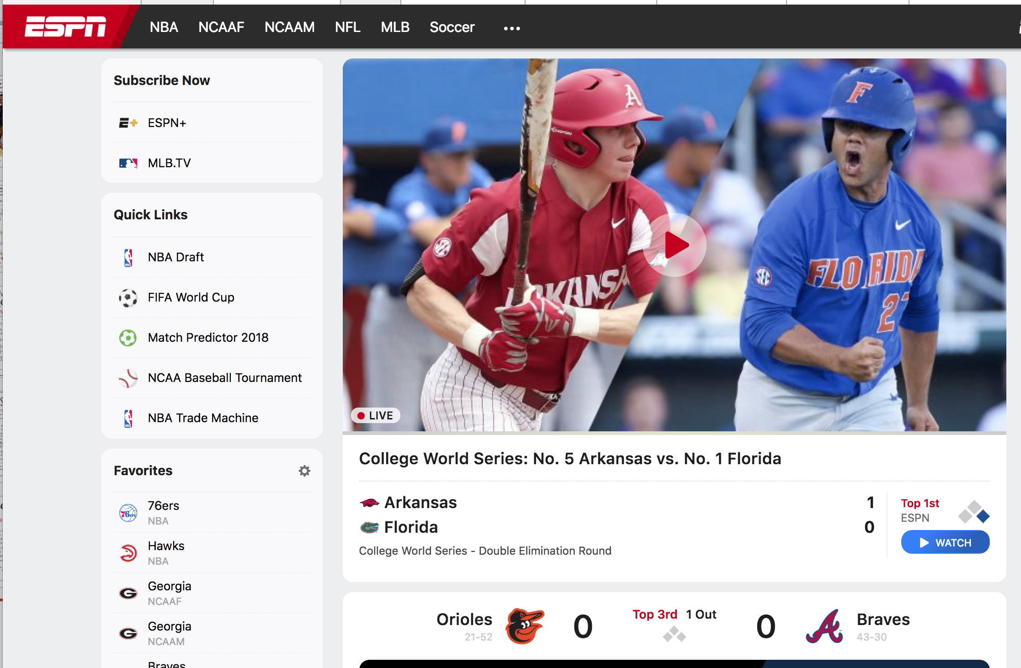
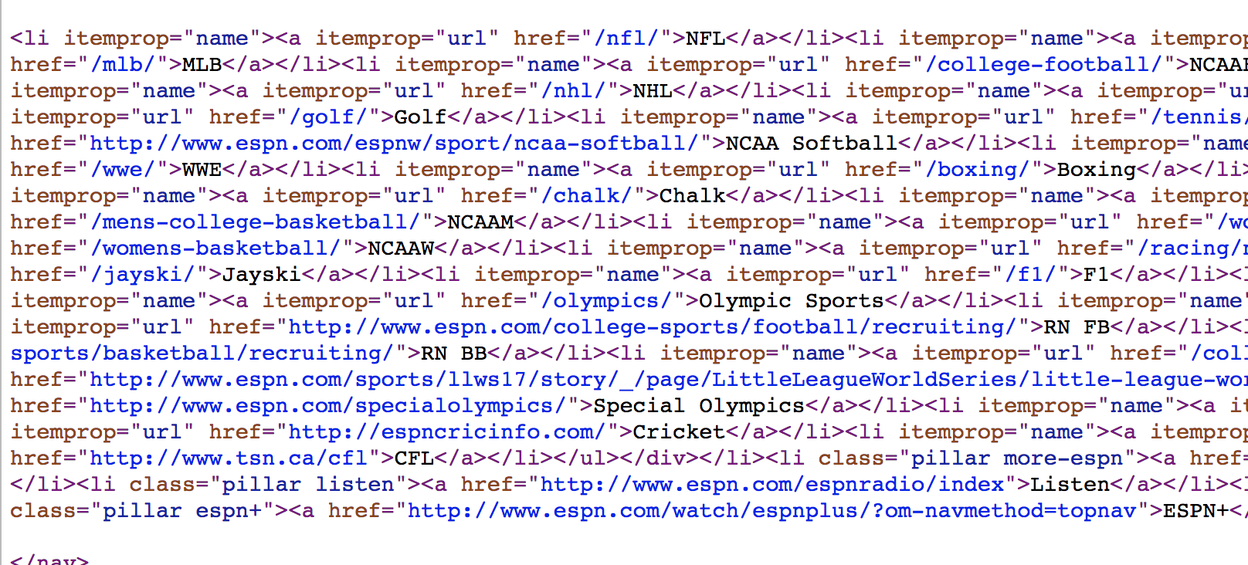
Code runs everywhere (often invisible)

Slide 8
Computer Programs
CODE
(abstract language for computer, entered as text)
CONSOLE
(program where computer processes code, aka
compiler or interpreter)
VIEWER
(computer output)

Slide 9
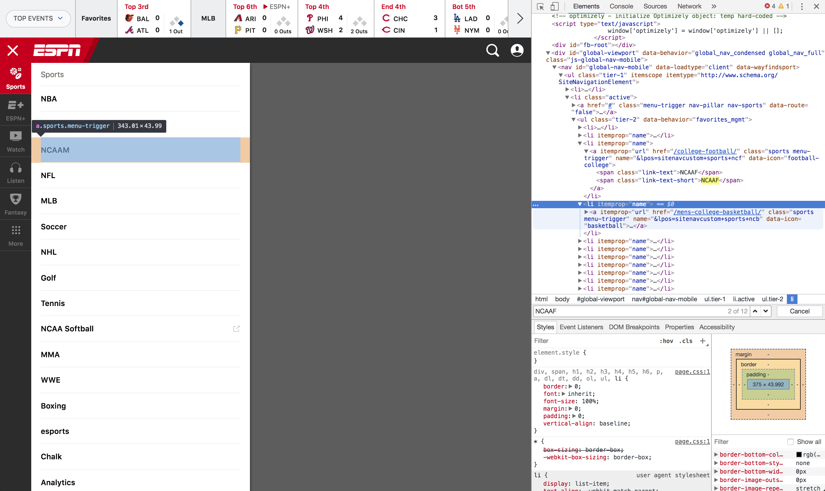
CODE
VIEWER

Slide 10
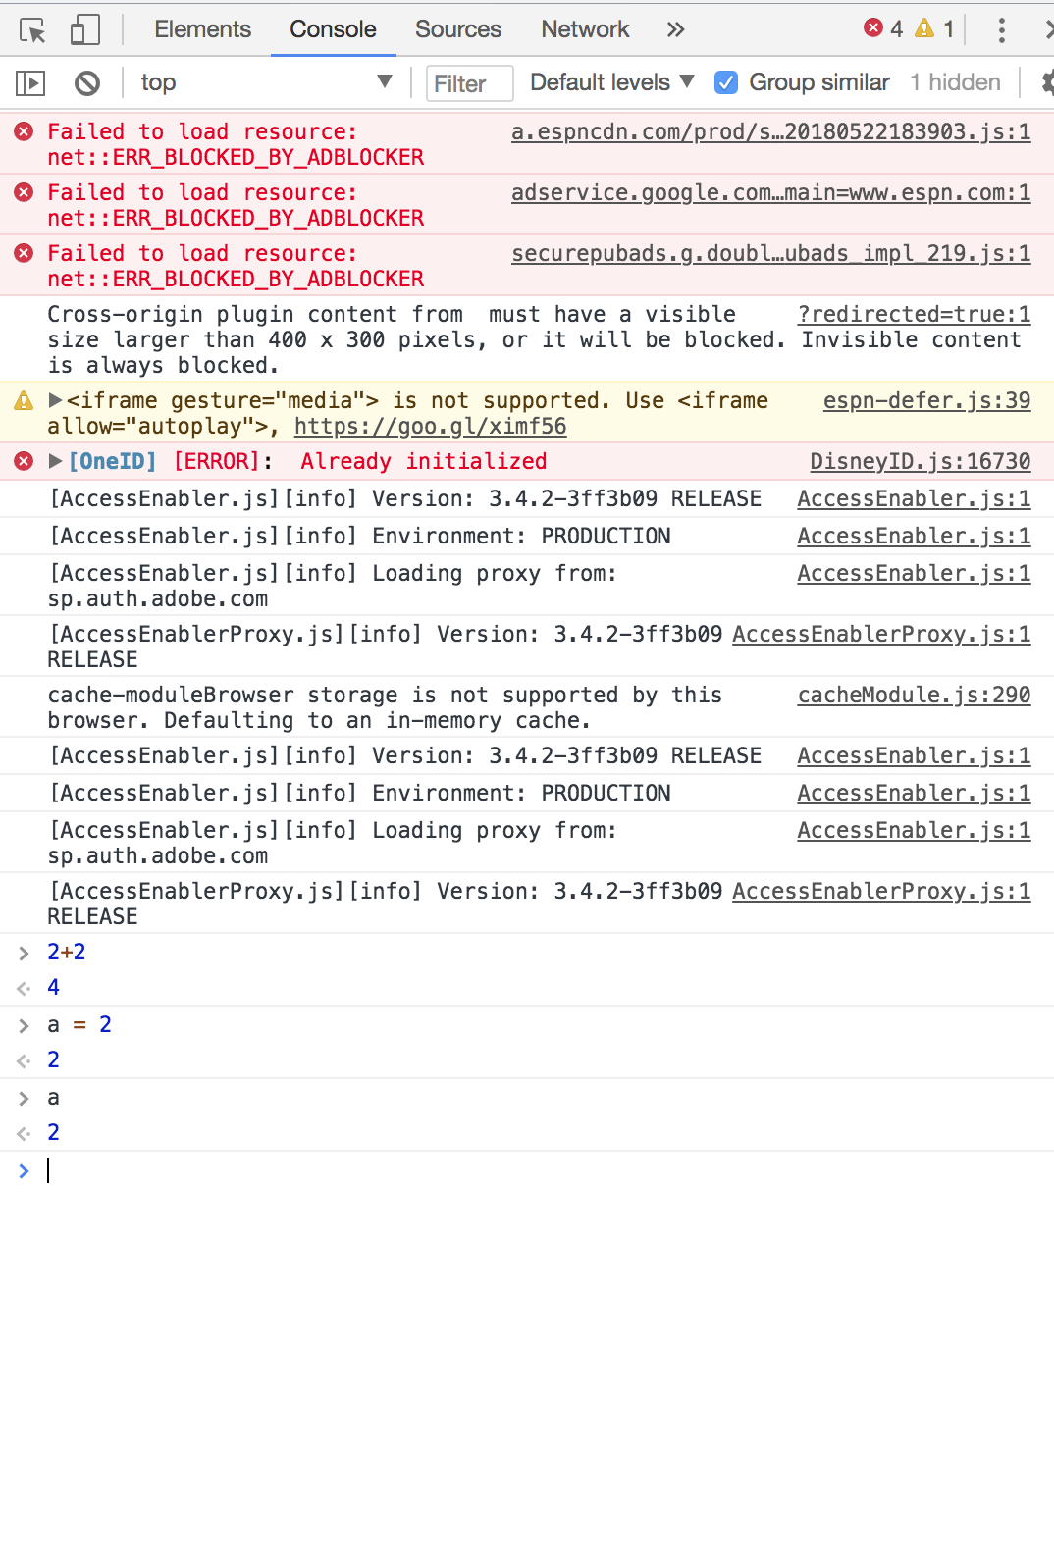
CONSOLE

Slide 11
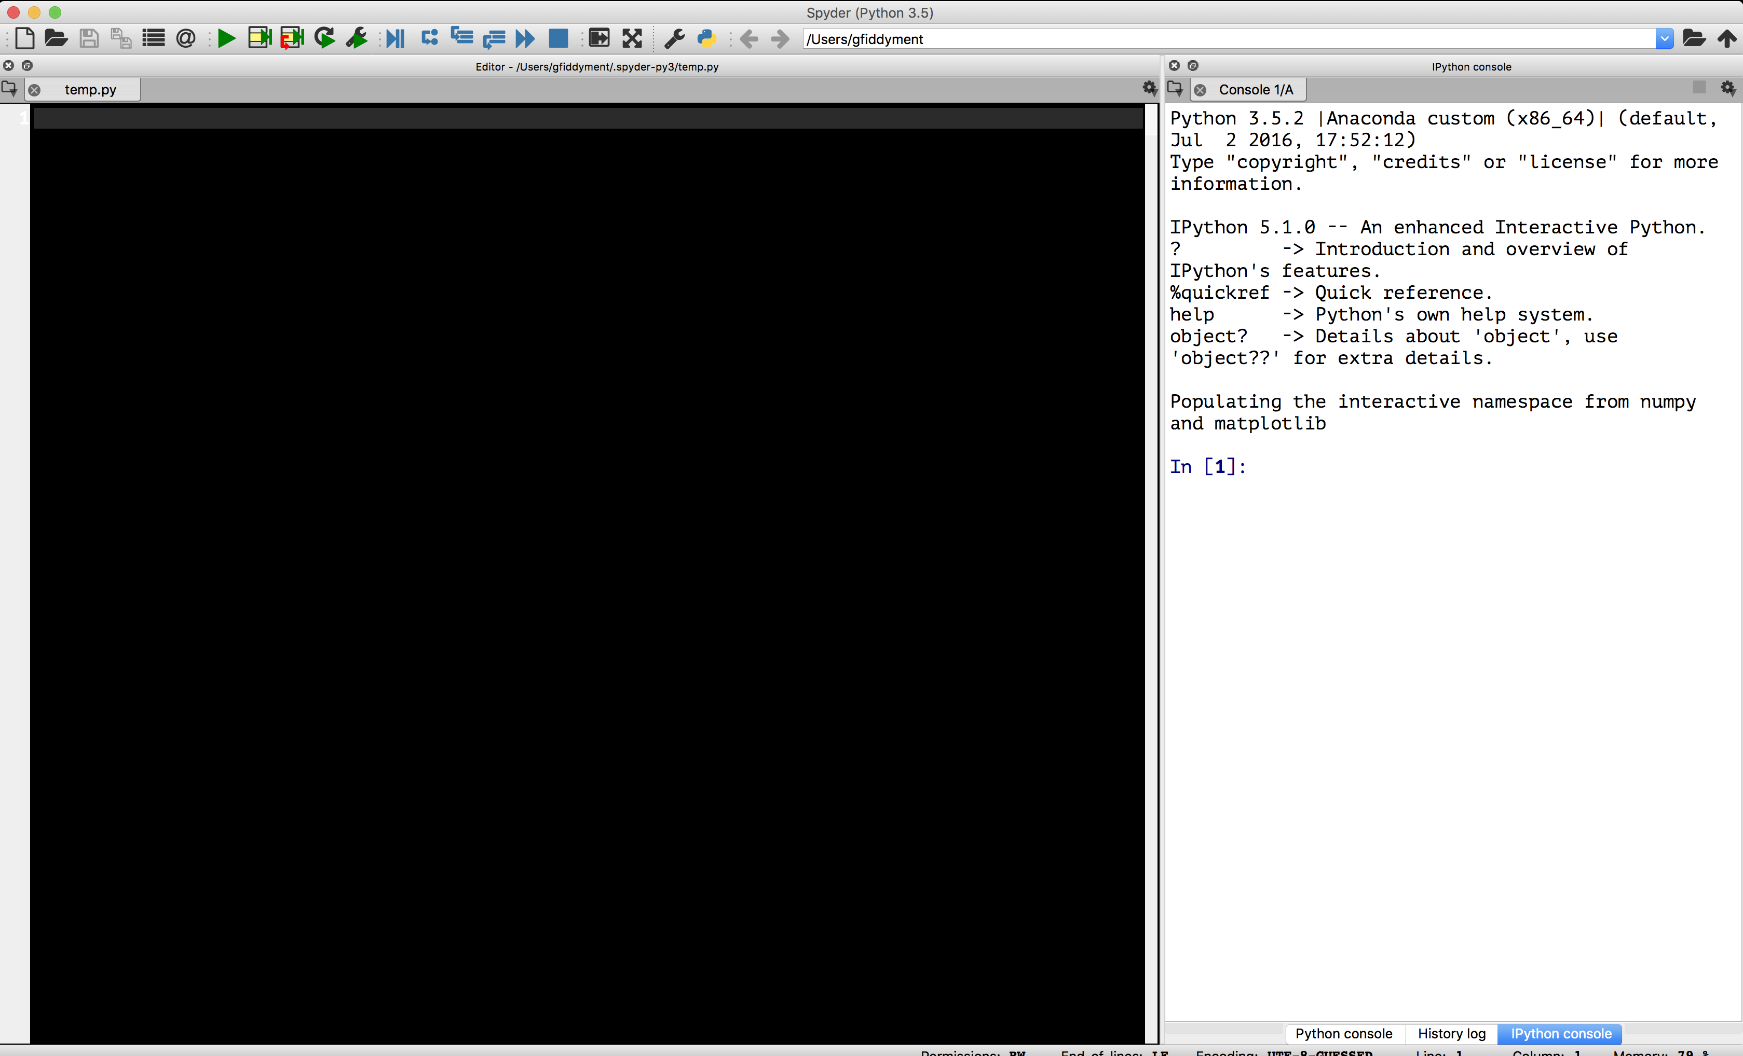
Spyder
CONSOLE/
VIEWER
CODE

Slide 12
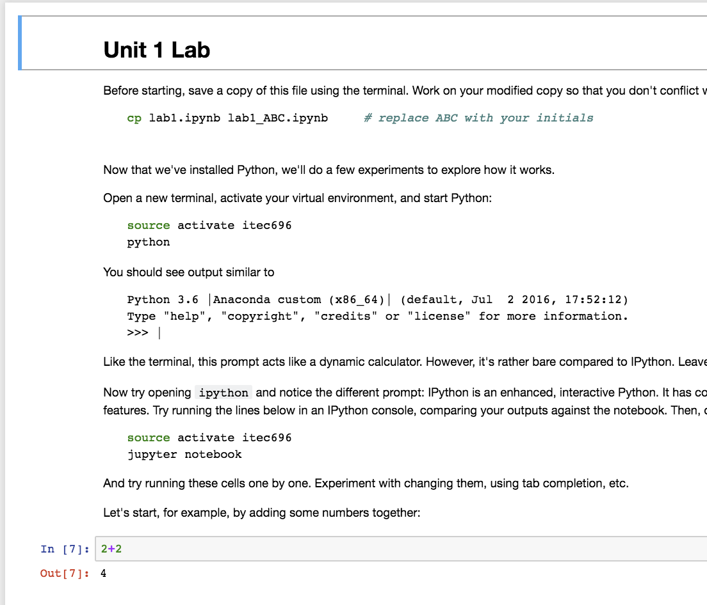
Jupyter
Notebook
Markdown
code cell
Python code
IPython console

